Slide 1


Intro to DevOps and Beyond
Ravindu Nirmal Fernando

Slide 2

About Me
STL - DevOps @ Sysco LABS - Sri Lanka
MSc in Computer Science specialized in Cloud Computing (UOM)
AWS Certified Solutions Architect - Professional
Certified Kubernetes Administrator (CKA)
AWS Community Builder
Ravindu Nirmal Fernando
https://ravindunfernando.com

Slide 3

Session 01 - DevOps
Understanding DevOps - Why? How? What?
DevOps Practices
DevOps Tools and Technologies
Beyond DevOps – DevSecOps/ SRE/ Platform Engineering
Session 02 - The world of Containers
Brief history of Infrastructure Shifts over decades
Introduction to Containers/ Containers vs VMs
Introduction to Docker/ Docker Compose
Introduction to Container Orchestration with Docker Swarm & Kubernetes
Agenda
Session 03 - Infrastructure As Code

Slide 4
500K+
Session 01 - DevOps
350K+
150K+

Slide 5

The Era before DevOps
Notes:
Now we are in an era where DevOps is a more frequent term in the industry.
But to truly understand what is DevOps, we have to go back in the timeline and understand the issues and struggles in the industry that lead the way for DevOps.

Slide 6






Developers
Focused on Agility
Operators
Focused on Stability

Slide 7




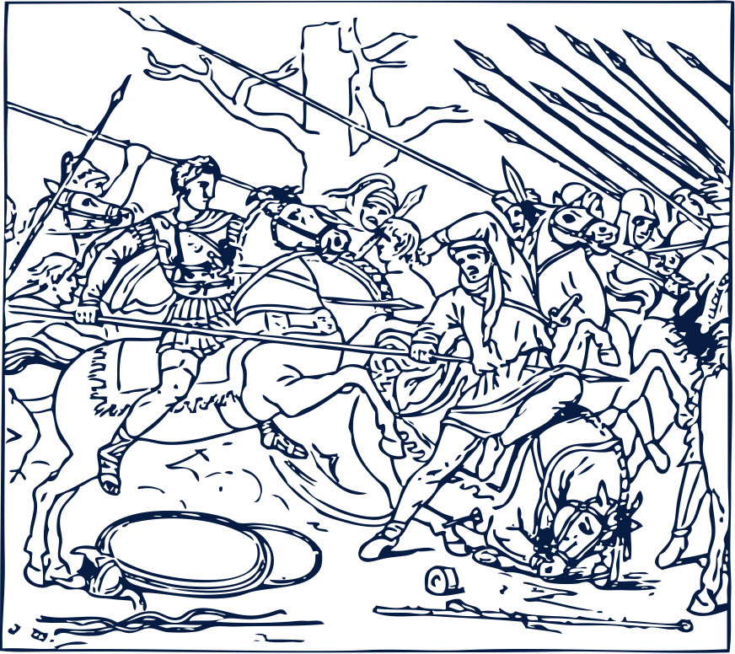
"Destructive downward spiral in IT" - Gene Kim
Act 01 - Operations teams maintaining large fragile applications
Act 02 - The product managers
Larger, unrealistic commitments made to the outside world (client/ investors) without understanding the complexities behind development and operations
Doesn't have any visibility on the application, whether or not its working as expected
Act 03 - The Developers
Act 04 - Dev and Ops at war
Developers taking shortcuts and putting more and more fragile code on top of existing ones
"It worked on my machine" phenomenon

Slide 8

How can we overcome these issues?

Slide 9
“DevOps is the combination of cultural philosophies, practices, and tools that increases an organization’s ability to deliver applications and services at high velocity”
- What is DevOps? [AWS] -
“A compound of development (Dev) and operations (Ops), DevOps is the union of people, process, and technology to continually provide value to customers.”
- What is DevOps? [Azure] -
DevOps allows evolving and improving products at a faster pace than businesses using traditional software development and infrastructure management processes. This speed allows businesses to serve their customers better and compete effectively.

Slide 10


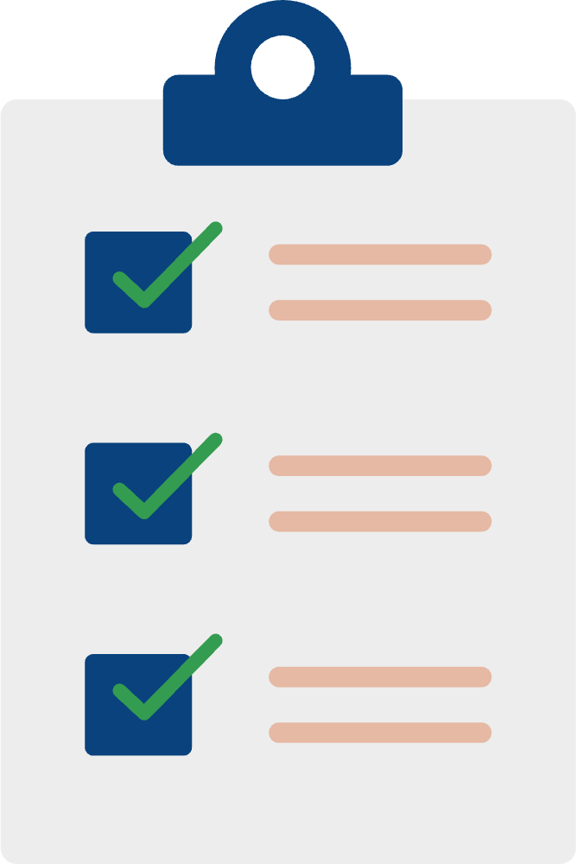


Key Areas in DevOps
Reduce Organizational Silos
Accept Failure as Normal
Everyones shares the ownership of production and information is shared among everyone
Blameless PMs/ RCA. Risk taking mindset.
Implement Gradual Changes
Leverage Tooling and Automation
Frequent deployments, frequent deterministic releases in small chunks which can be rolled back
Automate and reduce manual work as much as possible
Measure Everything
Application, systems monitoring and metrics etc...

Slide 11

DevOps Practices

Slide 12
Continuous Integration (CI) - Software development practice where developers regularly merge their code changes into a central repository, after which automated builds and tests are run.
Continuous Delivery (CD) - Software development practice where code changes are automatically built, tested, and prepared for a release to production (automated code change deployment to staging/ pre-production system).
Continuous Deployment (CD) - Every change that passes all stages of the pipeline will be deployed into production (released to customers). This practice fully automates the whole release flow without human intervention and only a failed test will prevent a new change being deployed.
Microservices - The microservices architecture is a design approach to build a single application as a set of small services with each focusing on SRP. Each service can be created, deployed and run independently.
Notes:
CI - Ensures that application is not broken when new commits are added to the main branch with automated tests
C Delivery - Automated releases for pre-prod environments with a click of a button. You can decide when to release these changes to production. You should plan to release small batches, frequently.
C Deployment - Goes one step further than continuous delivery.

Slide 13
Infrastructure as Code - A practice in which infrastructure is provisioned and managed using code and software development techniques, such as version control and continuous integration.
Configuration Management
Policy as Code
GitOps - builds on the concept of IaC, incorporating the functionality of Git repositories, merge requests (MRs) and CI/CD to further unify software development and infrastructure operations. GitOps incorporates managing both infrastructure and applications as code.
Cloud Infrastructure - Cloud provides more flexibility, scalability and toolsets for organizations to implement DevOps culture and practices. Serverless architecture in cloud brings down the efforts of DevOps teams as it eliminates server management operations.
Continuous Monitoring, Logging and Alerting - Organizations monitor metrics and logs to see how application and infrastructure performance impacts the experience of their product’s end user. Combined with real time alerts organizations can do a real time analysis on the application status.
Notes:
Iac - We talked about one step environment creation in the First Way in the Three Ways concept

Slide 14
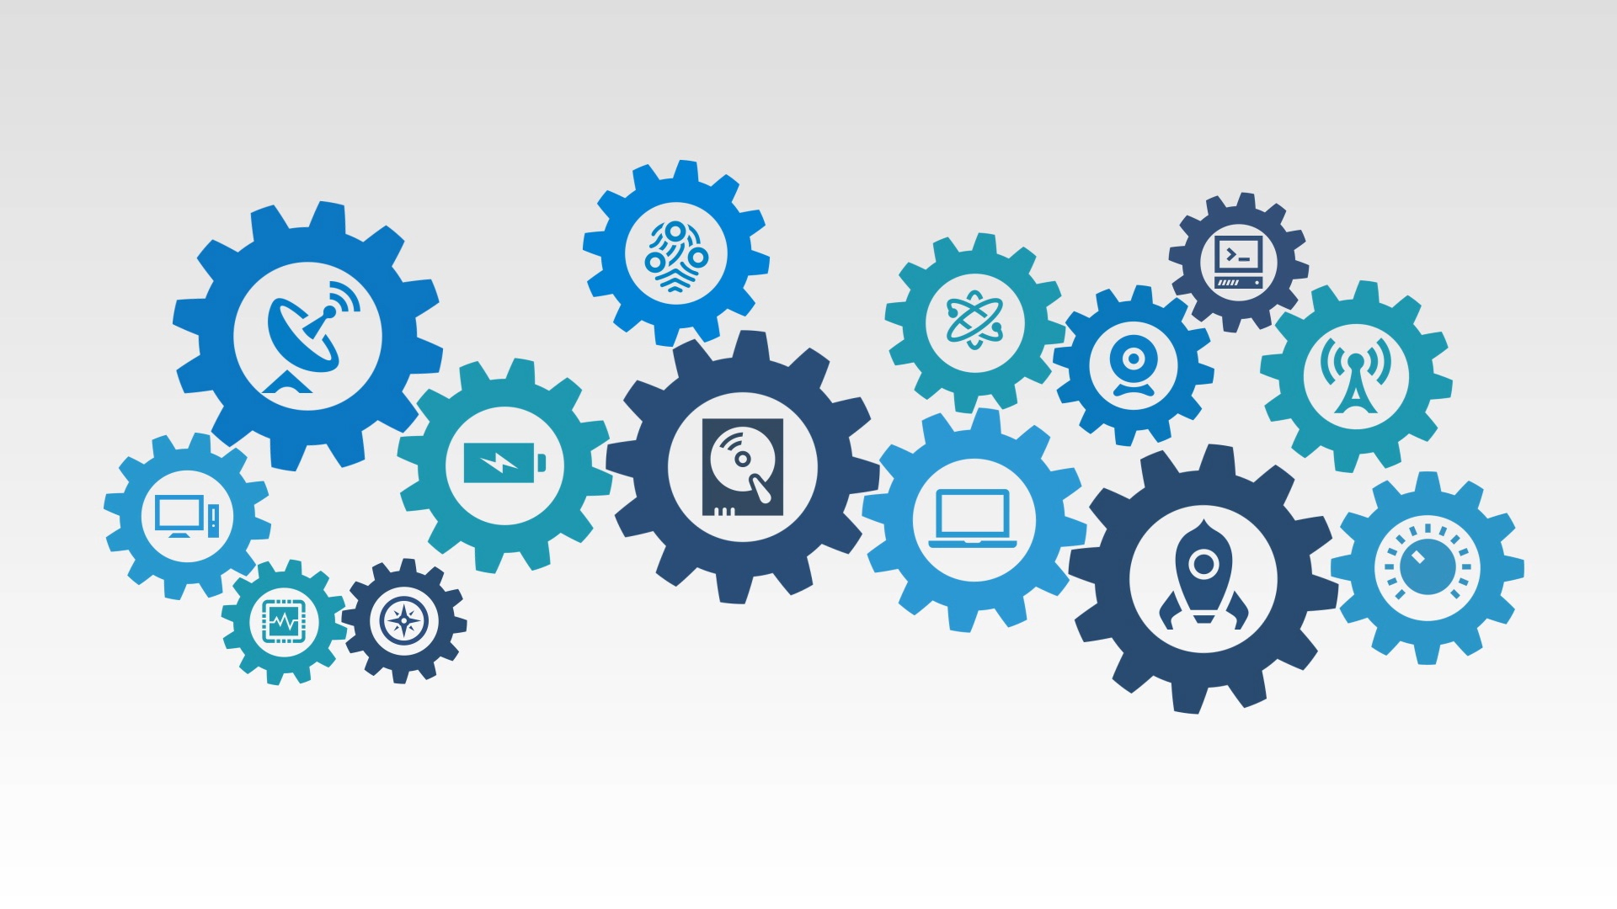
DevOps Tools and Technologies

Slide 15
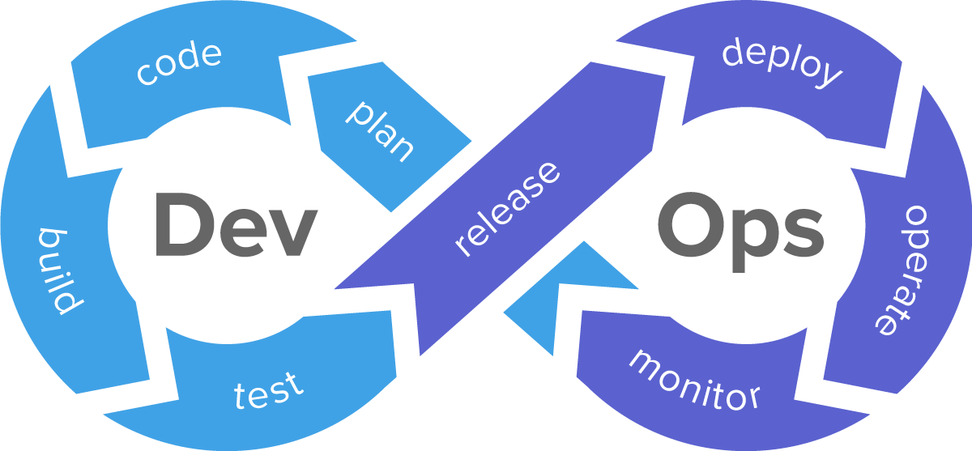

Slide 16
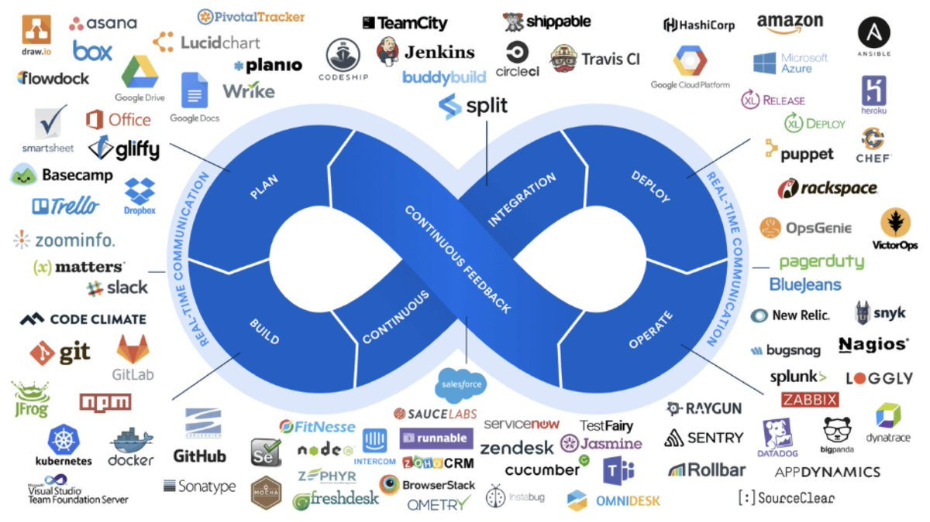

Slide 17
Beyond DevOps

Slide 18
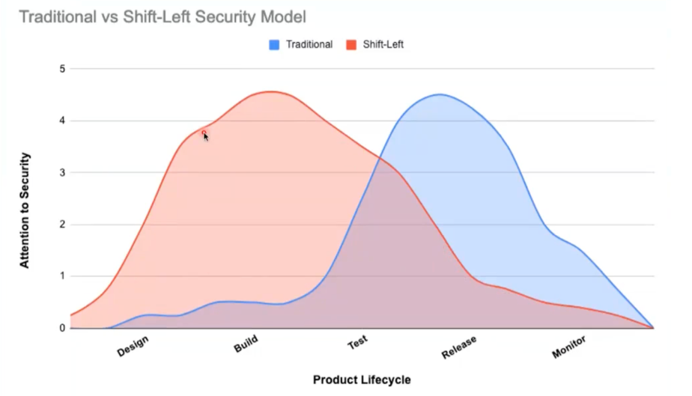
DevSecOps
Idea of moving Security in the early stages of the SDLC pipeline
"the practice of integrating security into a continuous integration, continuous delivery, and continuous deployment pipeline"

Slide 19
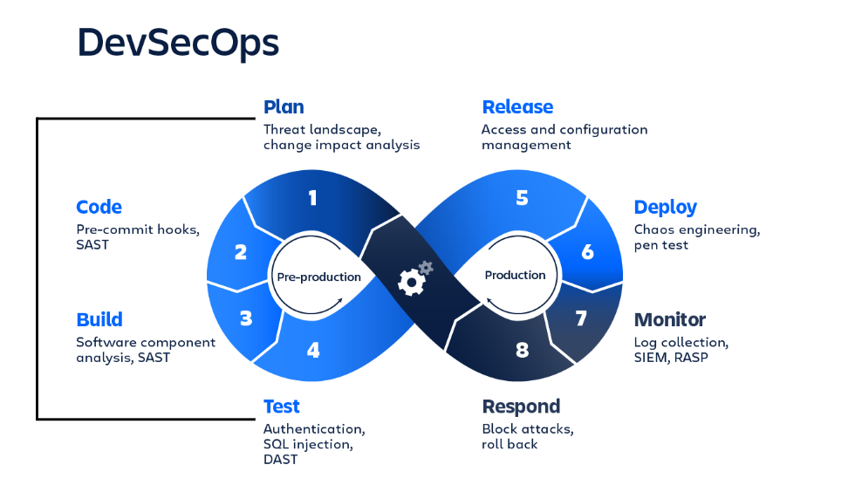

Slide 20
SRE (Site Reliability Engineering)
Not competing with DevOps
Think that Class SRE implements Interface DevOps
SRE is a part of the DevOps umbrella
SRE Practices
- Identify and measure SLIs, define SLOs and agree/ commit to SLA for product and service
- Chaos Engineering
- Removing toil
- System designing (DR, Multi-Region, Mult-Cloud)
- Postmortems/ Root Cause Analysis
- Observability

Slide 21
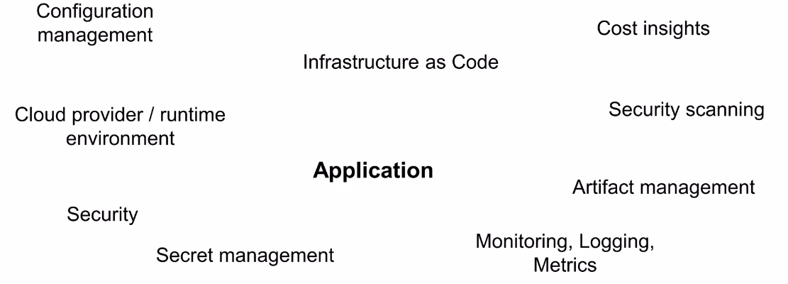
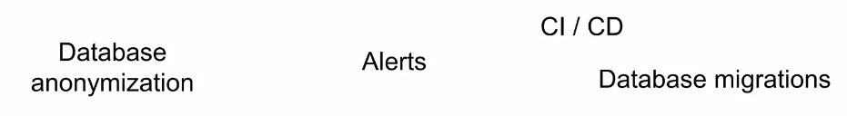
Platform Engineering
Before jumping to definition, let’s understand the problem…

Slide 22
“The composition and integration of a set of processes, tools and automation (components) to build a coherent platform with the goal of empowering developers to be able to easily build, maintain and deploy their business logic”

Slide 23
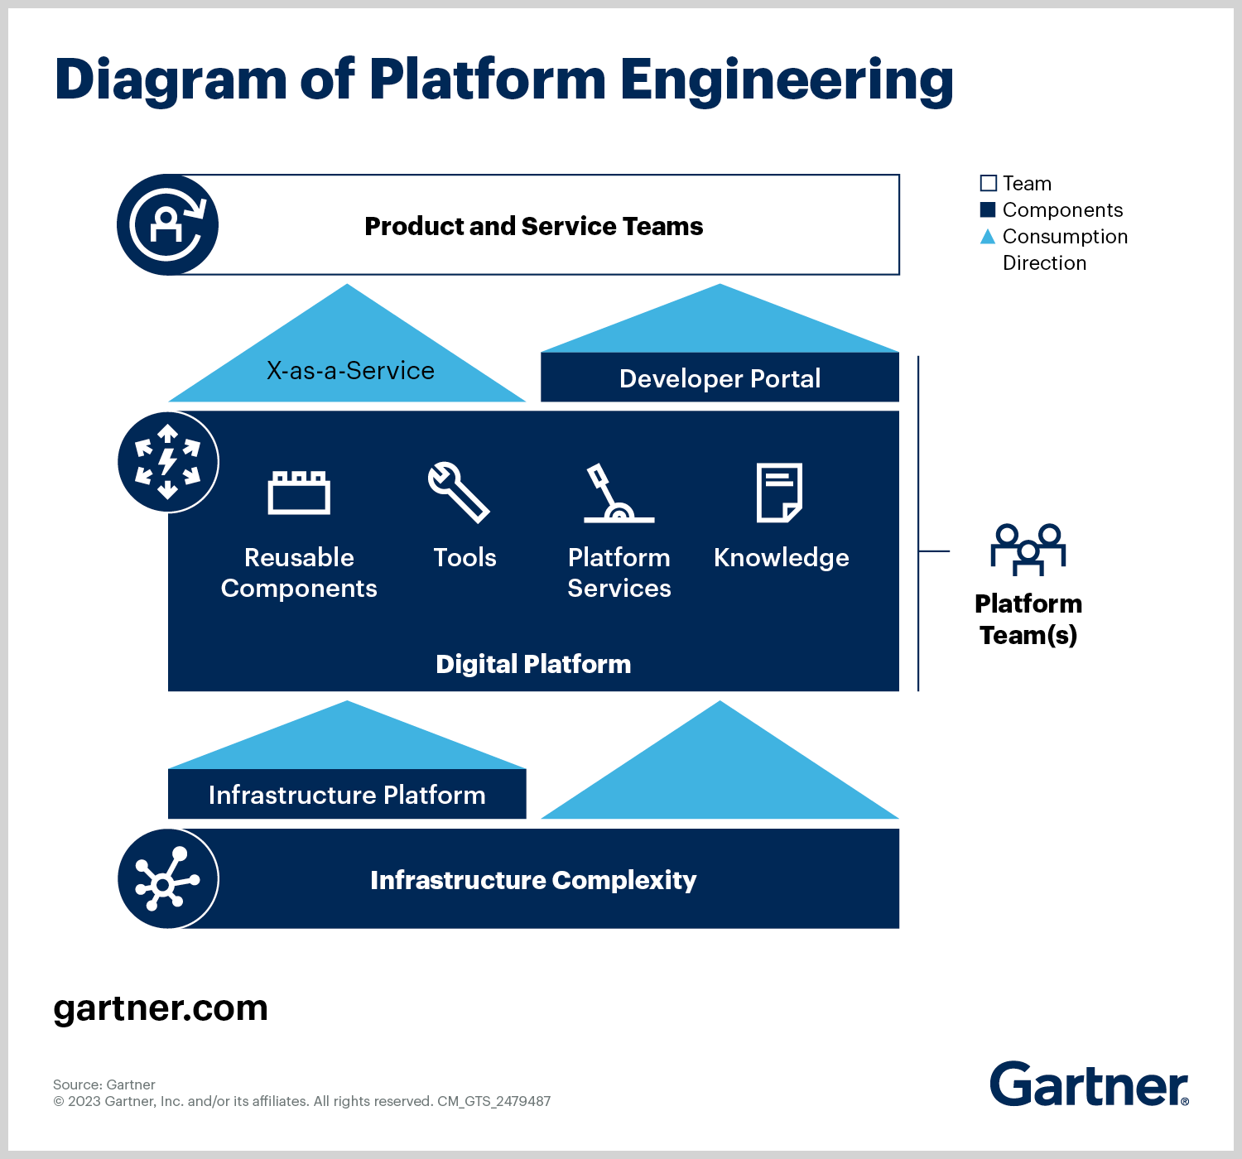

Slide 24


Carrier as a DevOps Engineer

Slide 25


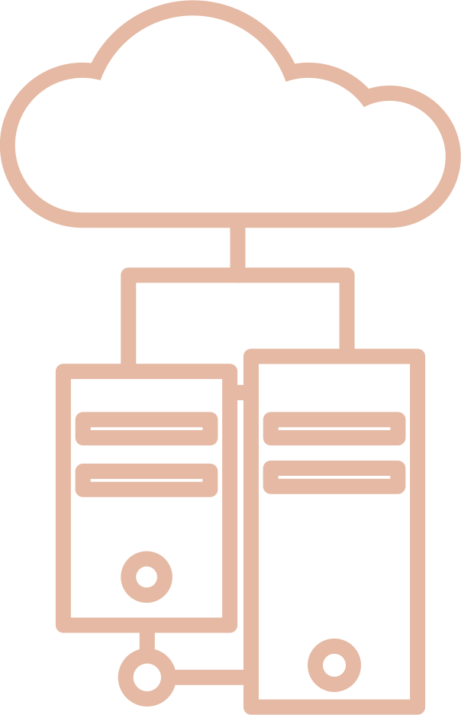



DevOps Engineer Role
CI/ CD Management & Automation
Cloud Deployment and Management
Infrastructure Management
Performance Assessment and Monitoring
Writing Specifications and Documentation
Assisting with DevOps culture apdotion
Notes:
For internships,
Software Development knowledge will be definitely an advantage (Don't go with DevOps thinking you don't have to do coding there). Focus should be the excitement to jump into learning many new tool stacks and most importantly a way of thinking.
Will differ from company to company
Basic understanding of working with Linux (specially in terminal), scripting (Bash/ Python), knowledge in containerization tool (Docker), basic knowledge in a CSP (either AWS, GCP) knowledge, understanding on DevOps practices etc...
More specified job roles in DevOps like SRE, Release Engineer etc...
Like an class is implemented by and interface with abstract methods, you can say
class SRE implements DevOps
class Release_Eng implements DevOps

Slide 26
References
https://sre.google/sre-book/table-of-contents/
https://www.gartner.com/en/articles/what-is-platform-engineering
https://youtu.be/uTEL8Ff1Zvk?si=5QT_LrzedX-BMezt

Slide 27

LinkedIn
https://www.linkedin.com/in/ravindufernando/
X (Twitter)
@ravindunf
Thank You!

